Slide 1
COMP2003HK
Computing Group Project
Group 5

Slide 2
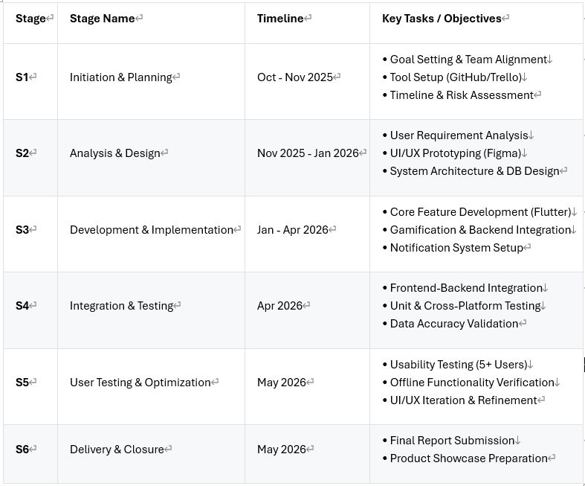
Project Planning Process

Slide 3
Demonstration of an initial prototype

Slide 4
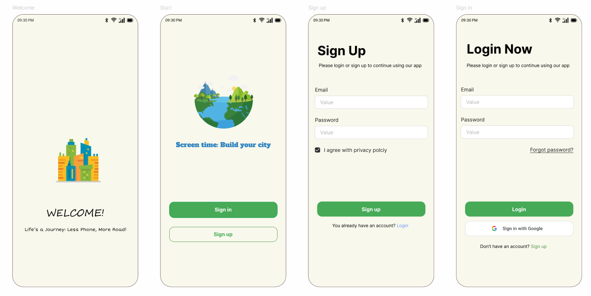
Welcome & User Login Page

Slide 5
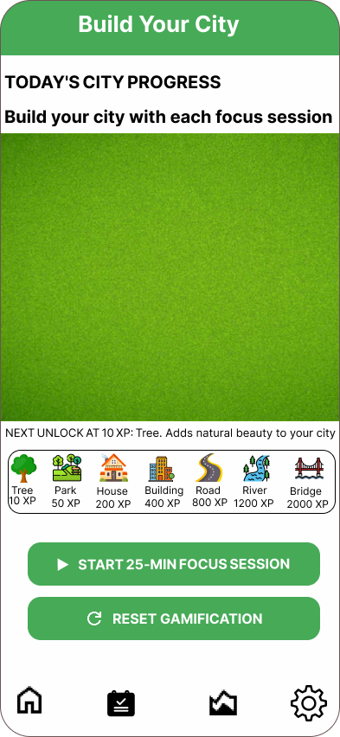
Home Page( Gamification )
Users earn XP by completing focus sessions
Spend XP to unlock building assets (trees, houses, roads)
Green spaces - drag & drop areas for personal utopia

Slide 6
Prioritized & Functionalities
MoSCoW method:
Must-have feature: Focus timers, city building, and activity logging form our core value
Should-have feature: Dashboards and notifications boost daily usage
Could-have features: like custom city themes remain optional for future iterations.
Won't-have features: such as leaderboards or social sharing were excluded to maintain privacy focus and scope control.

Slide 7
Technology Stack
Flutter: main development framework
Dart: programming language
SQLite: local database

Slide 8
Why This Combination Works
Single codebase for Android plus iOS
Smooth animations for city building
Secure offline data storage

Slide 9
Dashboard

Slide 10
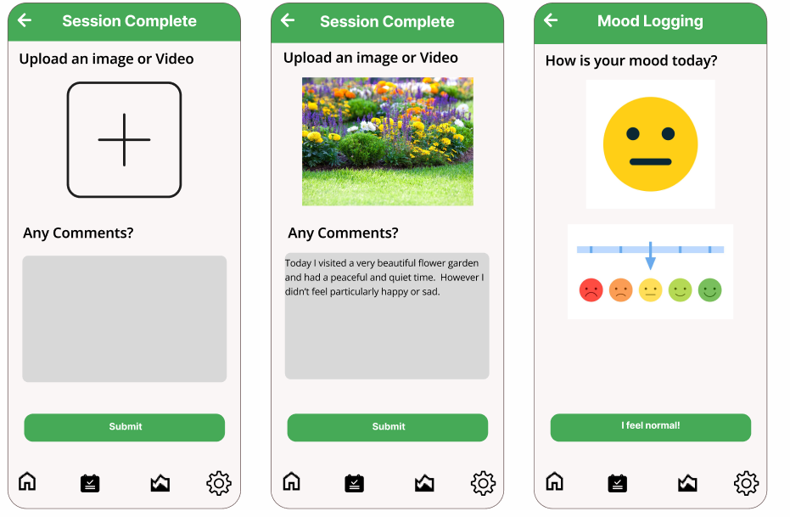
Session logging

Slide 11
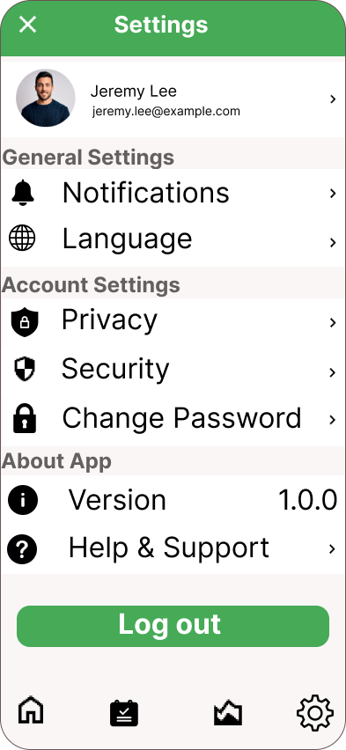
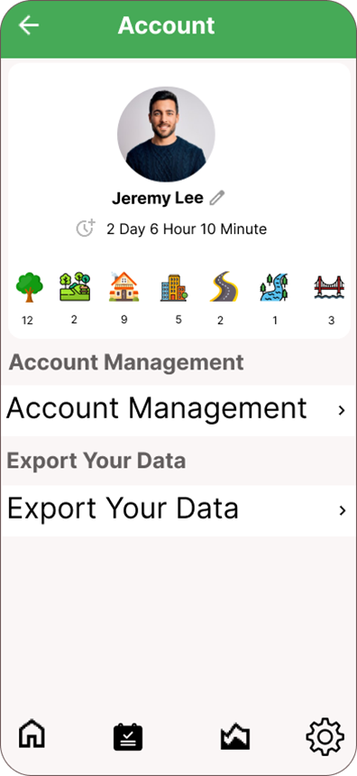
Setting Page

Slide 12
Q&A
Thank You

